Slide 1


DSP Final Project Blind source separation
Team Members:
NGO ANH TUAN
NGUYEN MANH CUONG

Slide 2

Content Detail
Concept
System Construction
Scope

Slide 3
Concept
What Is Blind source separation(BSS)?
Blind source (BSS) is a signal processing technique that aims to separate multiple source signals from a set of mixed signals, without any prior knowledge about the sources or the mixing process. The goal is to recover the original source signals from the observed mixtures, typically using statistical and computational methods. BSS has applications in various fields such as audio signal processing, image processing, and telecommunications
It is used to extract useful information from mixed signals and to improve the quality of the source signals

Slide 4
System Construction
To make things a bit easier further on in this project:
Use two source input with none noise
Channels do not change over time
Team use scipy wave to as file reader
Use linear mix to mix source input
Gaussian model and entropy to separation from mix source

Slide 5
System Construction

Slide 6
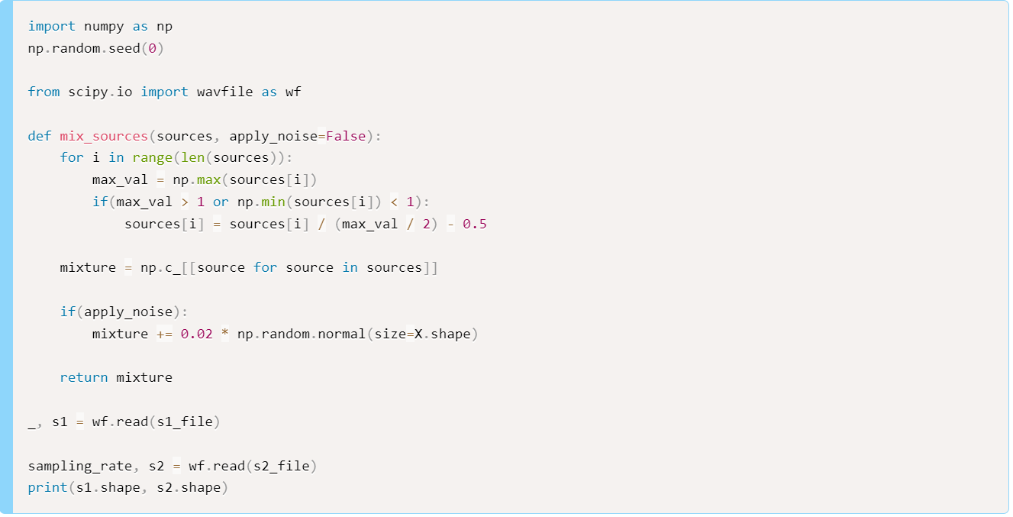
Mix source

Slide 7
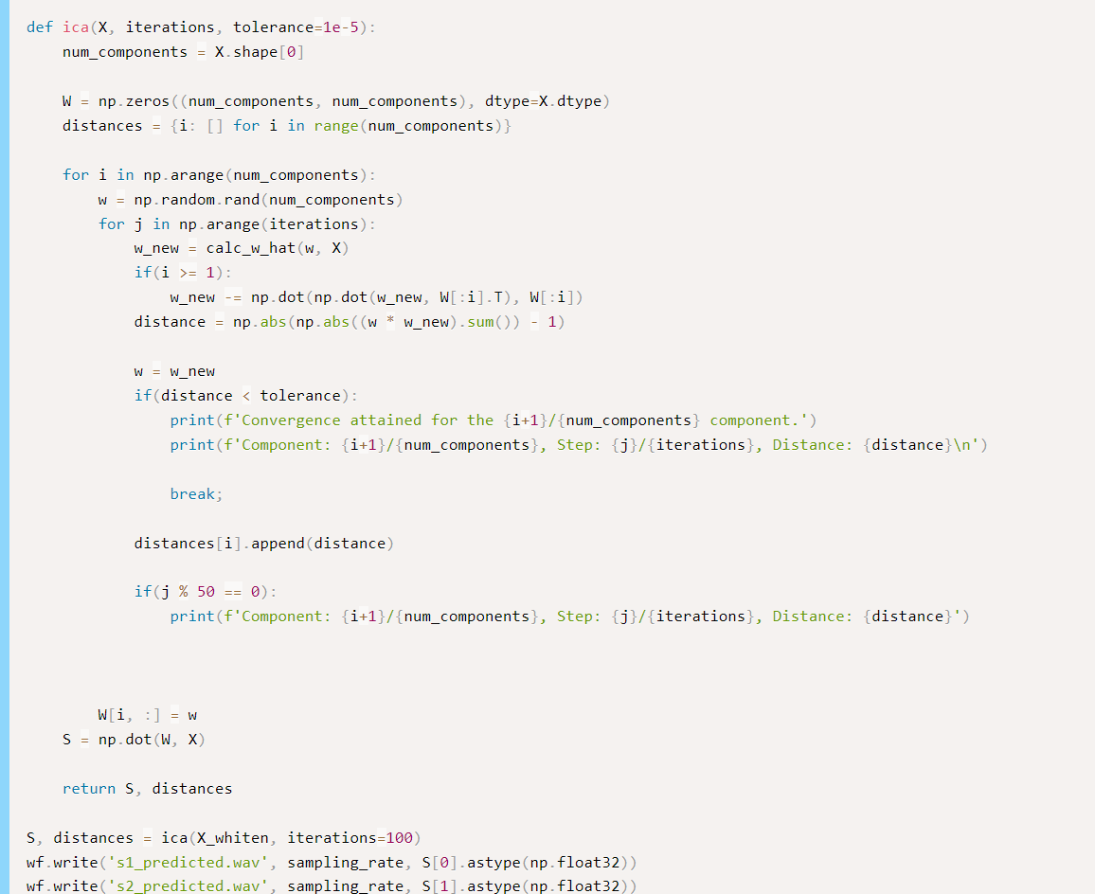
Separation source

Slide 8





Discuss
Efficacy
Value
Spend

Slide 9

Thank You!
tuan23mse13141@fsb.edu.vn

